Slide 1
Contents

Slide 2
INTRODUCTION
Disease prediction is a critical task while designing medical diagnosis software.
Major techniques used: Artificial intelligence and neural network
Recently, Machine Learning techniques have been successfully utilized in a different applications including to assist in medical diagnosis.
Effortless and on time process
Appropriate data-> More efficient result

Slide 3
Objective of the project
Take symptoms
Analyse disease
Provide best remedy

Slide 4
Expected Outcome of the project:
Health consciousness in common peoples.
Which helps to build better healthy future.

Slide 5
Methodology
We first take in data from the user through a GUI in an application.
The data entered by the user is sent to a Support Vector Machine (SVM) model.
This model analyses the data and predicts the disease the user has contracted based on its probability in the dataset.
This disease data from this model is sent to a second Support Vector Machine model which analyses the data of the disease predicted, provides remedy and the cure.
The cure and remedy for the disease is stated based on the probability predicted. If the probability is low, then the disease is unlikely and the user will be advised to consult a doctor.

Slide 6
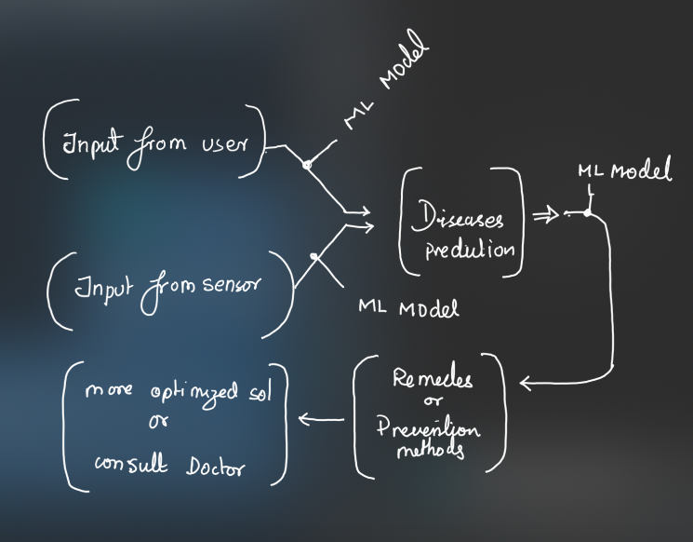

Slide 7
Individual Contribution:
Mohit Surana: Data set finding. Architecture design of project.
Rahul Reddy: Integrating the machine learning model to cloud.
Surya Gangaraj: Application development and training model.
Sanketh Bennur: Ui design and application debugging.

Slide 8
Result
The project aims at providing the data and the name of the disease contracted by the user.
The user can be acknowledged about the type of disease, the population suffering or contracted the disease.
The SVM model provides the remedy and cure for the disease.

Slide 9
Literature survey
Incorrect decisions are likely to purpose suspensions in medical treatment or even loss of life.
Normal medical diagnosis system->predicates before analyzing the disease. Hence less accurate with good performance.
System is only using one data set for validation which does not predictable enough to generate outcomes.
System is only exploring the common predictable performance of their models without considering the F-score and precision as measures.
Most studies do not provide statistical test results to demonstrate the level of significance of their experimental results.

Slide 10
Neural Network is improving the observation capacity of information systems over the training of a limited number of neural network’s nodes and collecting their results.
Proposed system is enhancing the performance and training of neural networks for the classification with using cross-validation tool for the optimizing the network parameters and architecture.

Slide 11
Literature Review:
Using Limitation of the profession and aspect for medical diagnosis system using machine learning improve the result as it:
• Provides an analysis of the automated data scrutiny.
• Significance the naive Bayesian, neural network,decision trees.
•Specific requirement for machine learning systems
i. Good Performance ii. Dealing with missing data iii. Dealing with noisy data iv. Reduction of the number of tests

Slide 12
Bibliography
Predictive Data Mining for Medical Diagnosis: An Overview of Heart Disease Prediction
(International Journal of Computer Applications (0975 – 8887) Volume 17– No.8, March 2011)
Using Associative Classifiers for Predictive Analysis in Health Care Data Mining
(International Journal of Computer Applications (0975 – 8887) Volume 4 – No.5, July 2010)
Machine learning, medical diagnosis, and biomedical engineering research- Commentary
https://doi.org/10.1186/1475-925X-13-94
Includes the latest back 3 years papers , which are related to the problem Domain
Depicting the Experimentation & Results

